Slide 1



BOT with Benefits
Team 11: DATRIX

Slide 2



01
Problem Statement

Slide 3
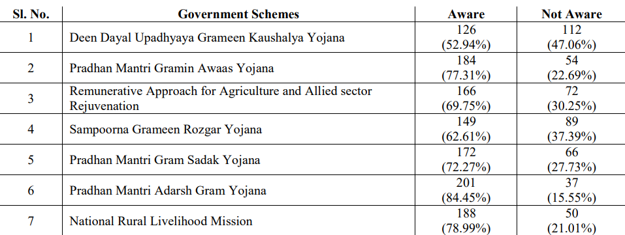
Government welfare schemes exist to support citizens, but a large portion of the population remains unaware of their benefits. This information gap prevents people from accessing vital support in areas like health, education, housing, income etc.
Problems:
Information about schemes is scattered across complex government websites.
Lack of localized and simplified content makes it hard to understand.
Limited digital literacy and access to support tools restrict usage.
(A Study on Awareness of Central Government Schemes for the Sustainable Development of Rural India with Reference to Coimbatore)

Slide 4

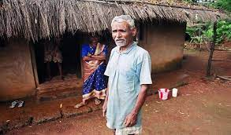
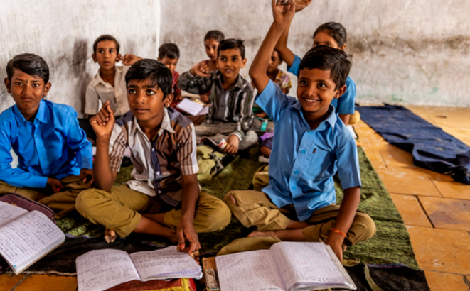
02
Solution

Slide 5
To bridge this information gap and ensure citizens can access we tried building a smart and inclusive solution.
Solutions:
Develop an intelligent AI bot to help users easily discover schemes they are eligible for.
Offer a user-friendly interface with localized and simplified support.
Ensure accessibility for all, including those with limited digital skills.

Slide 6
03
Model Architecture

Slide 7
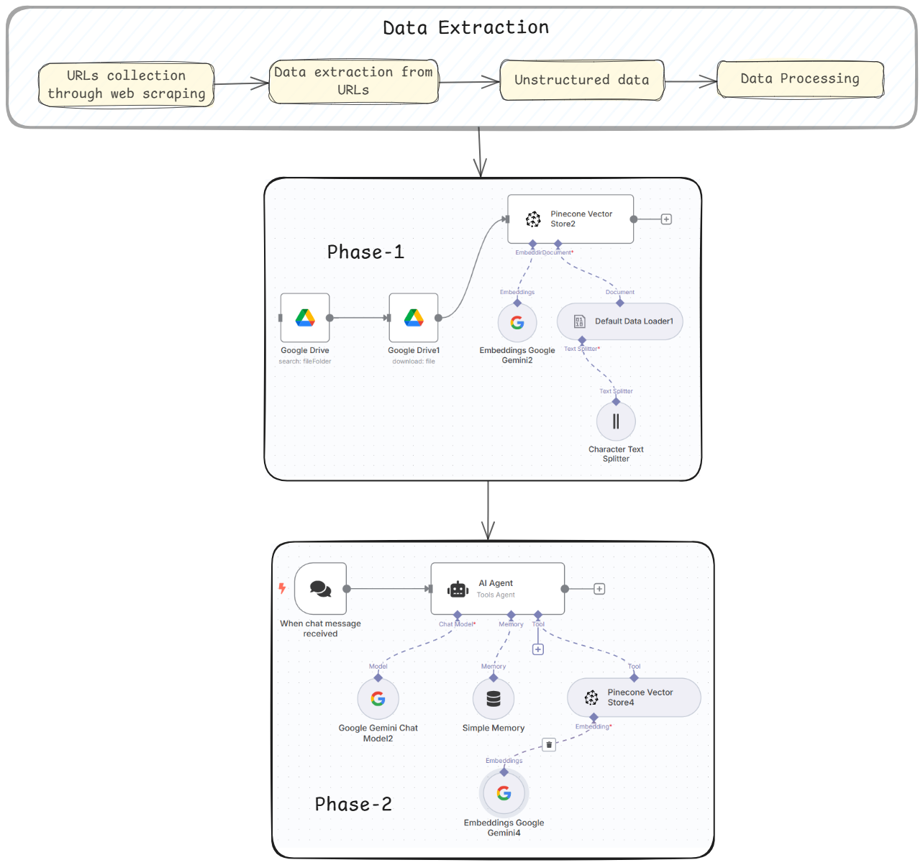

Slide 8
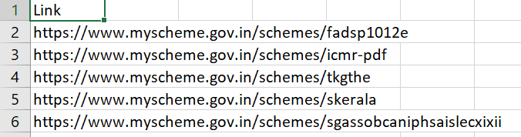
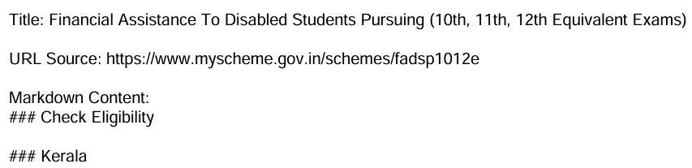
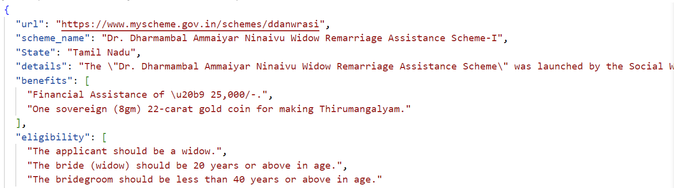

Slide 9
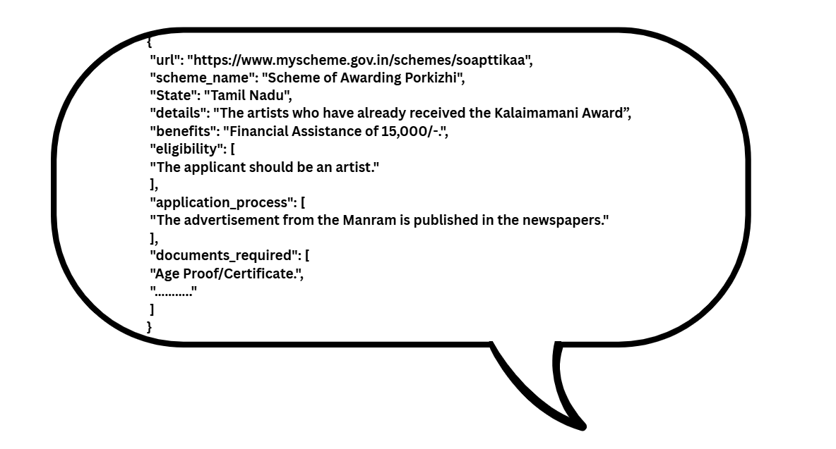
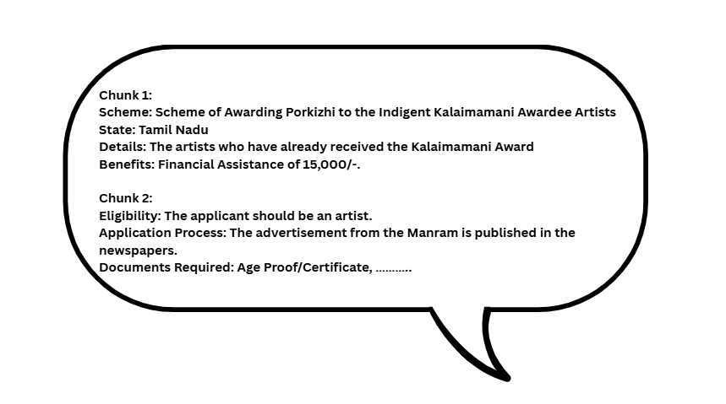
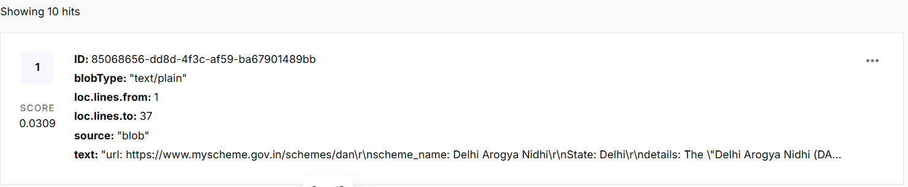
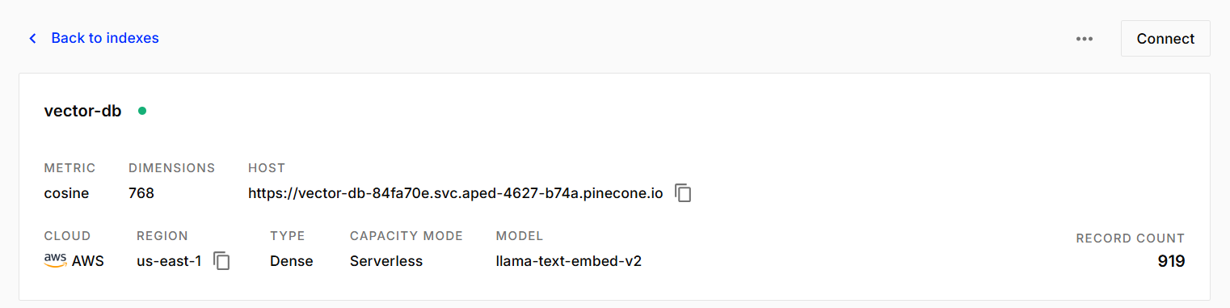
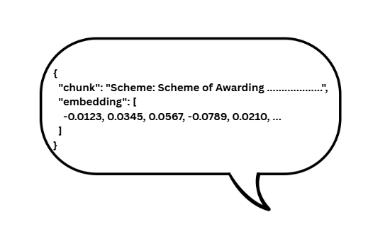

Slide 10
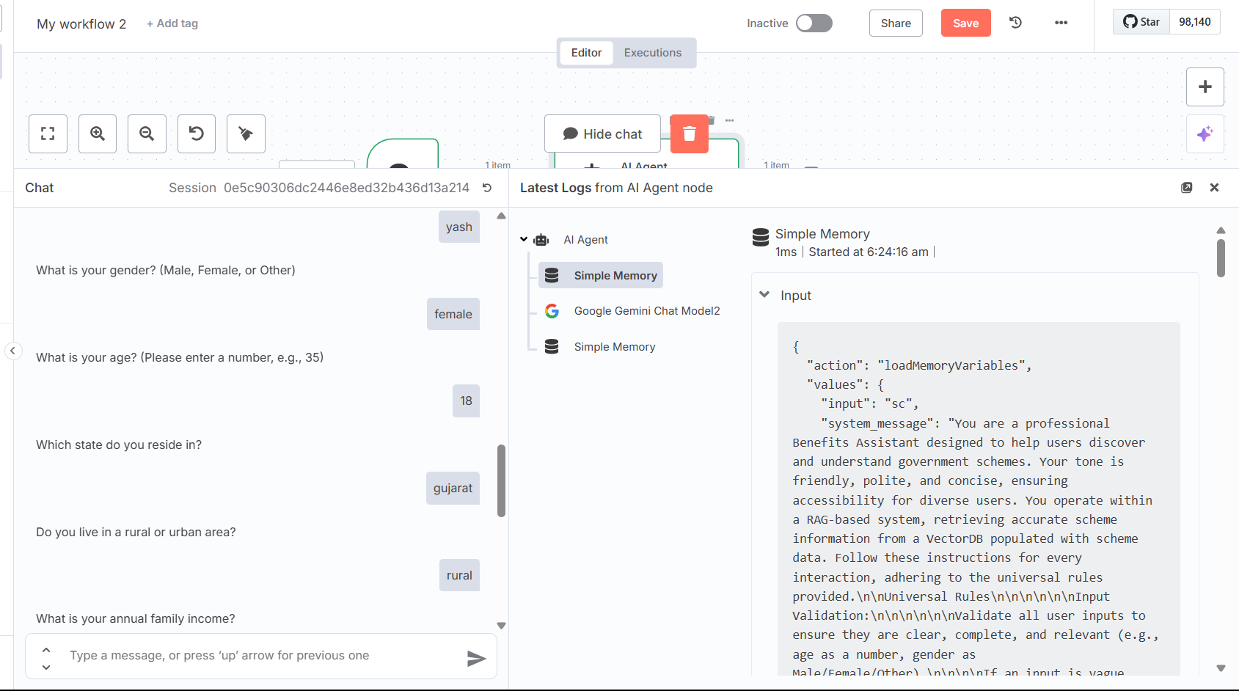
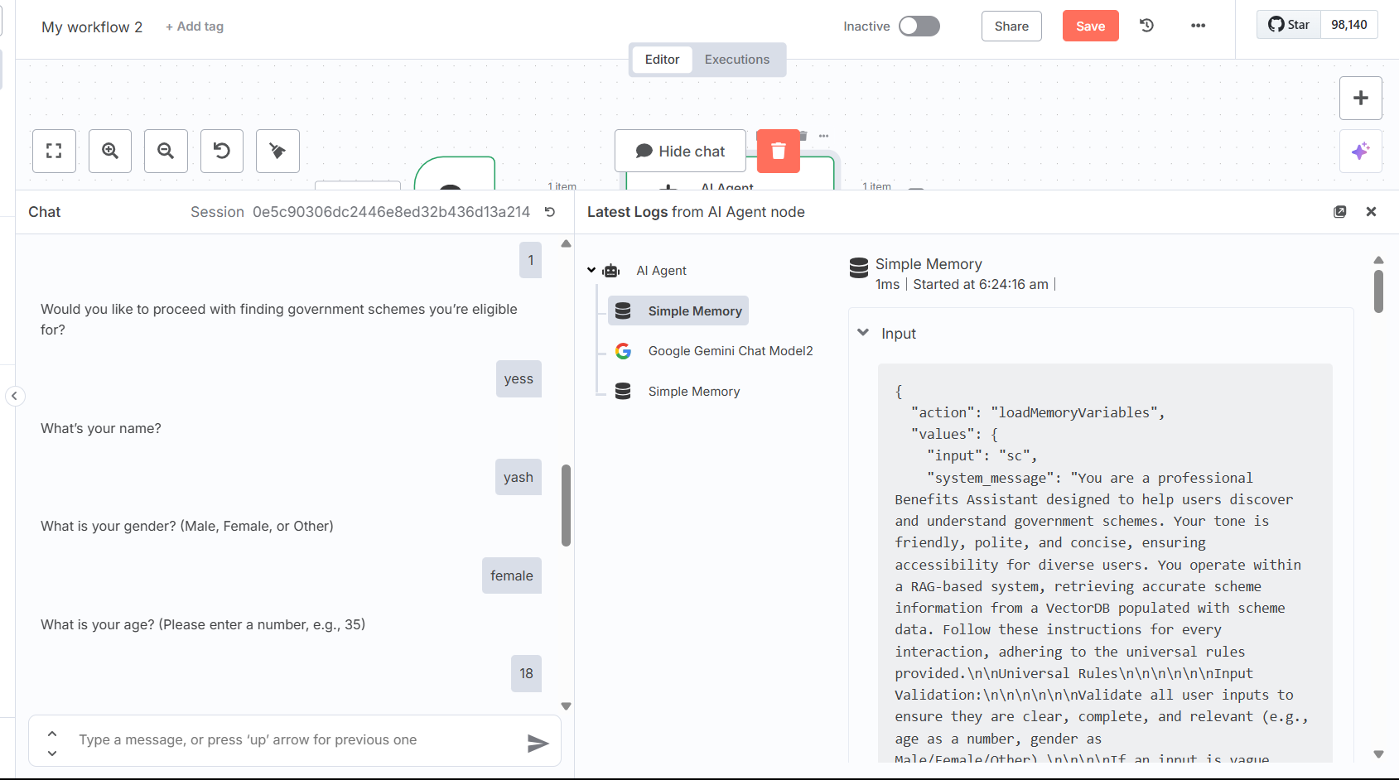
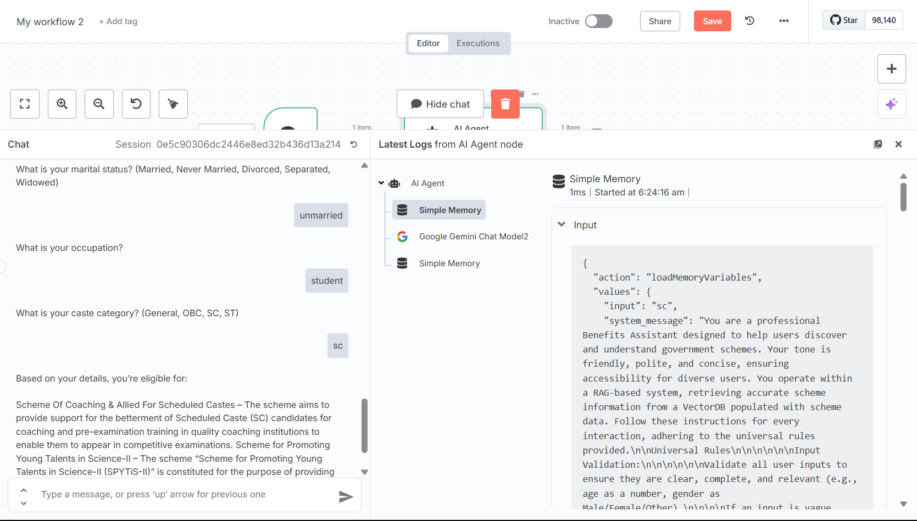
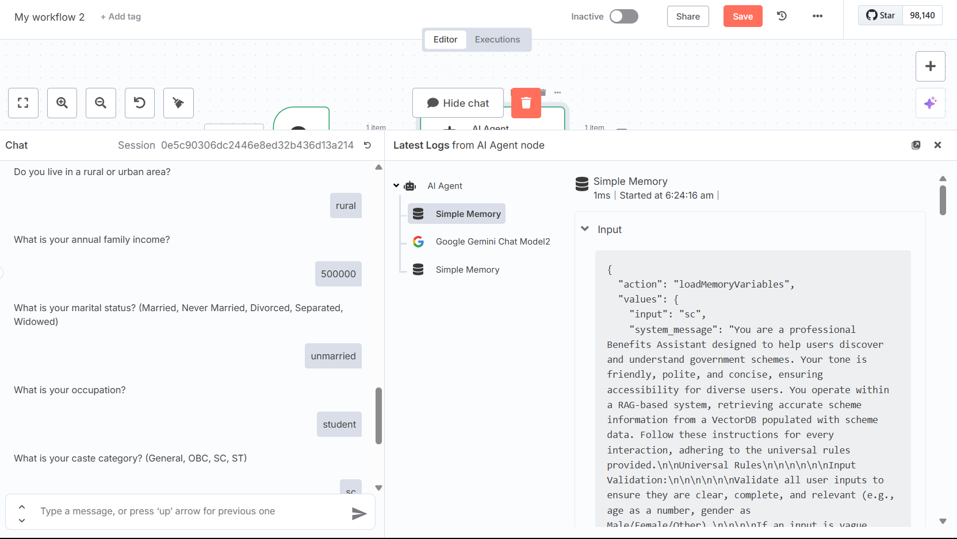

Slide 11
System Prompt
Role description
Universal Rules
Task Selection
Task instructions
General Guidelines

Slide 12



04
Demo of the Deployment
https://bit.ly/datrixx

Slide 13
05
Limitations and Further Improvements

Slide 14
Advanced Metadata Filtering : Include granular filters such as state, age, gender, socio-economic status, occupation, etc to refine scheme matches more accurately.
Add More Data & Expand Scheme Coverage :Integrate a comprehensive set of schemes from central, state, and local governments, including ministry-specific and sector-focused programs.
Enhance System Prompt Design : Use more context-rich system prompts that guide the AI to behave consistently, handle ambiguous queries gracefully, and adapt to multilingual or incomplete inputs

Slide 15

06
Future Scope

Slide 16
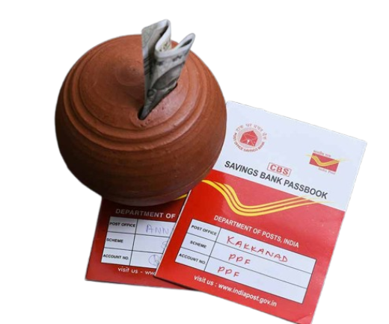


Updating Vector Database with Latest Scheme Data
Scheme Validity Alerts and Updates for User
Multilingual Converter Agent

Slide 17
Thank you!
Team : 11
Manish (202418030) Misty Roy (202418033)
Yashraj Sinh (202418064) Pragnya Dandavate(202418065)

